Slide 1


Hierarchical Bayesian estimation of motor-evoked potential recruitment curves
Vishu Tyagi
Data Scientist @Carmel Lab, Columbia University (Neurology)

Slide 2
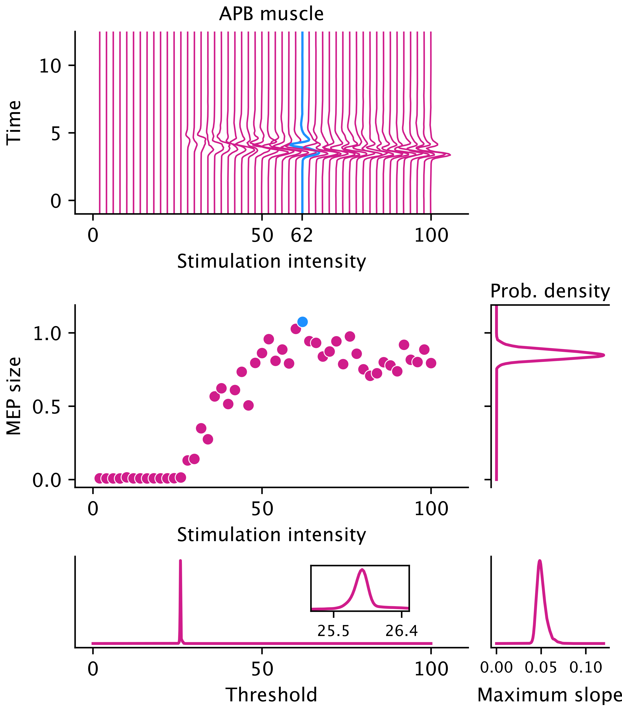
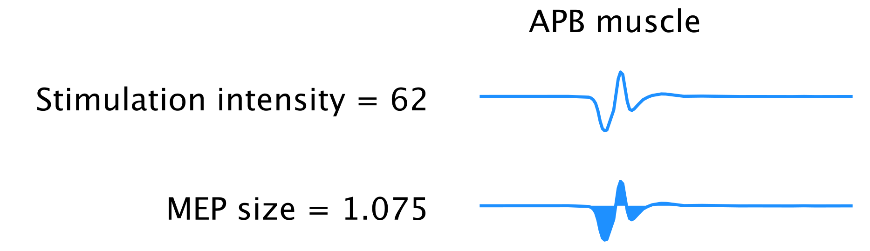
MEP recruitment curves
MEP – Motor-evoked potential
spinal cord stimulation
transcranial magnetic stimulation, etc. …
modulate neural activity

Slide 3
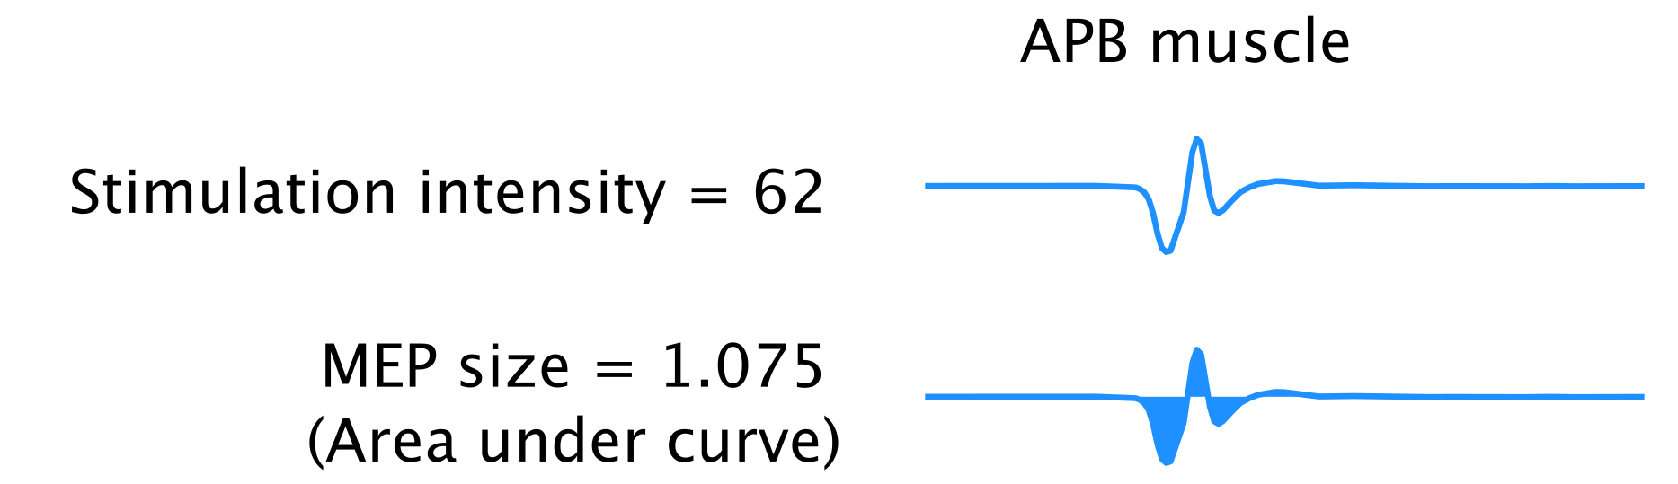
MEP recruitment curves
MEP – Motor-evoked potential
spinal cord stimulation
transcranial magnetic stimulation, etc. …
modulate neural activity

Slide 4
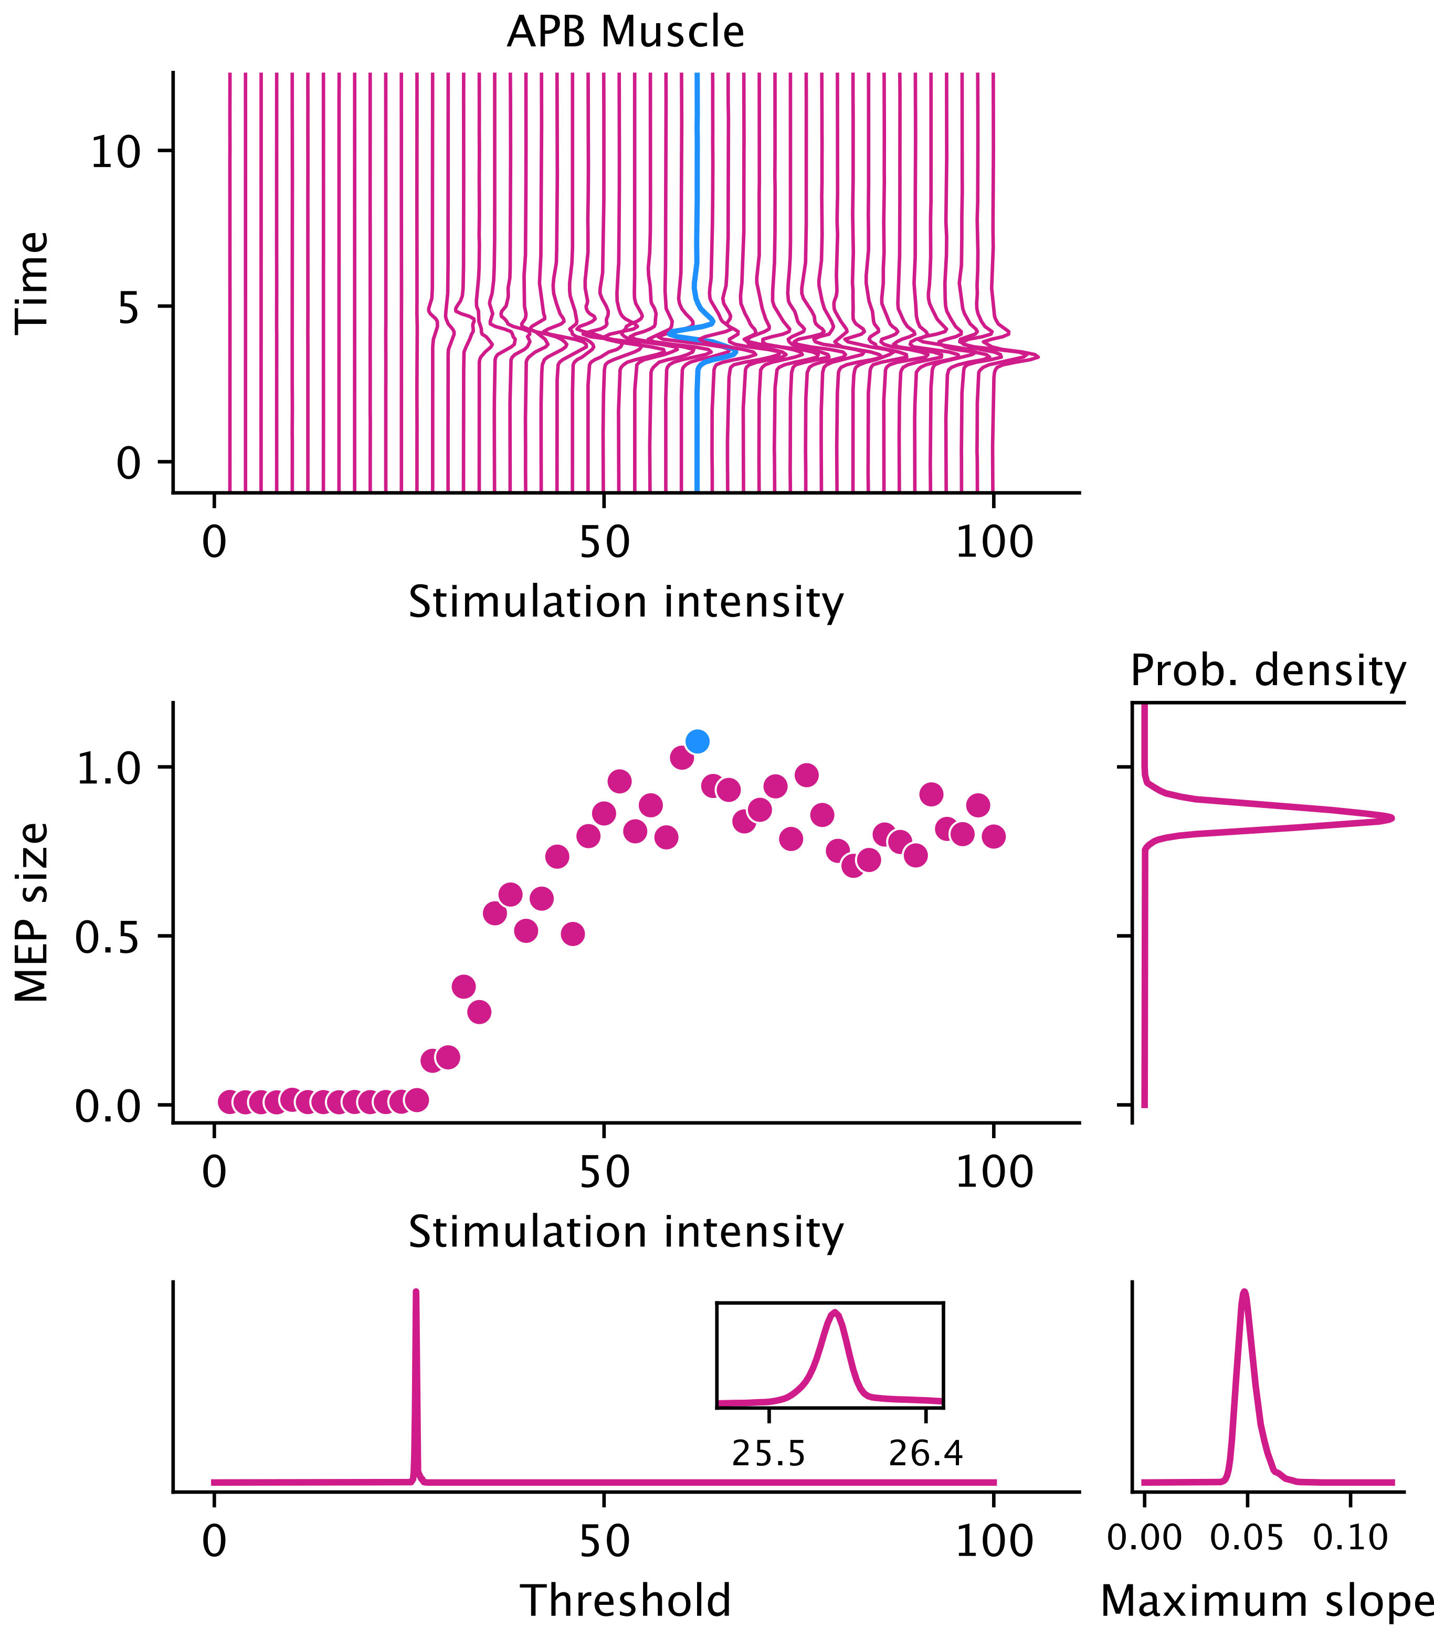
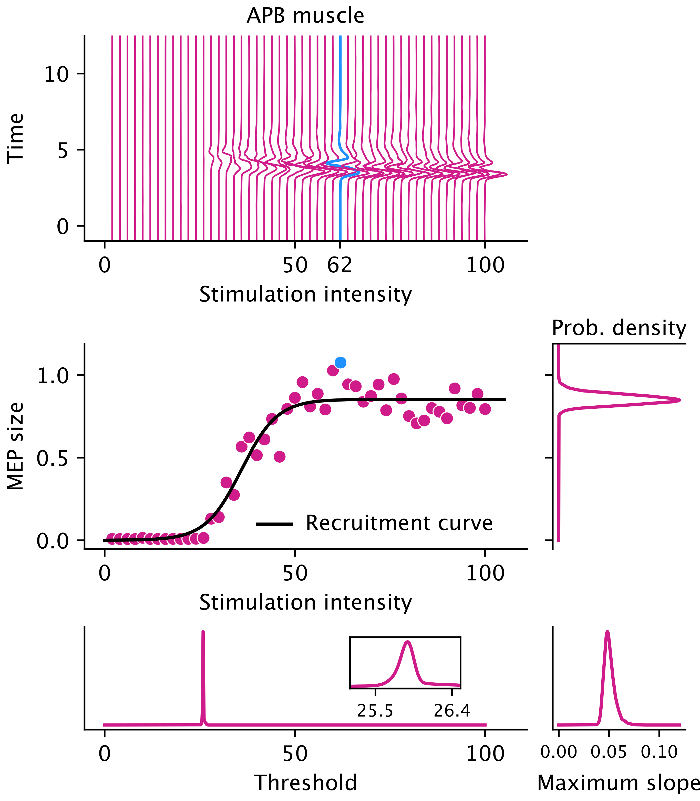
MEP recruitment curves
MEP – Motor-evoked potential
spinal cord stimulation
transcranial magnetic stimulation, etc. …
modulate neural activity
Recruitment curve
non-linear, non-decreasing function (usually a sigmoid)
Illustrate the recruitment of motor units

Slide 5
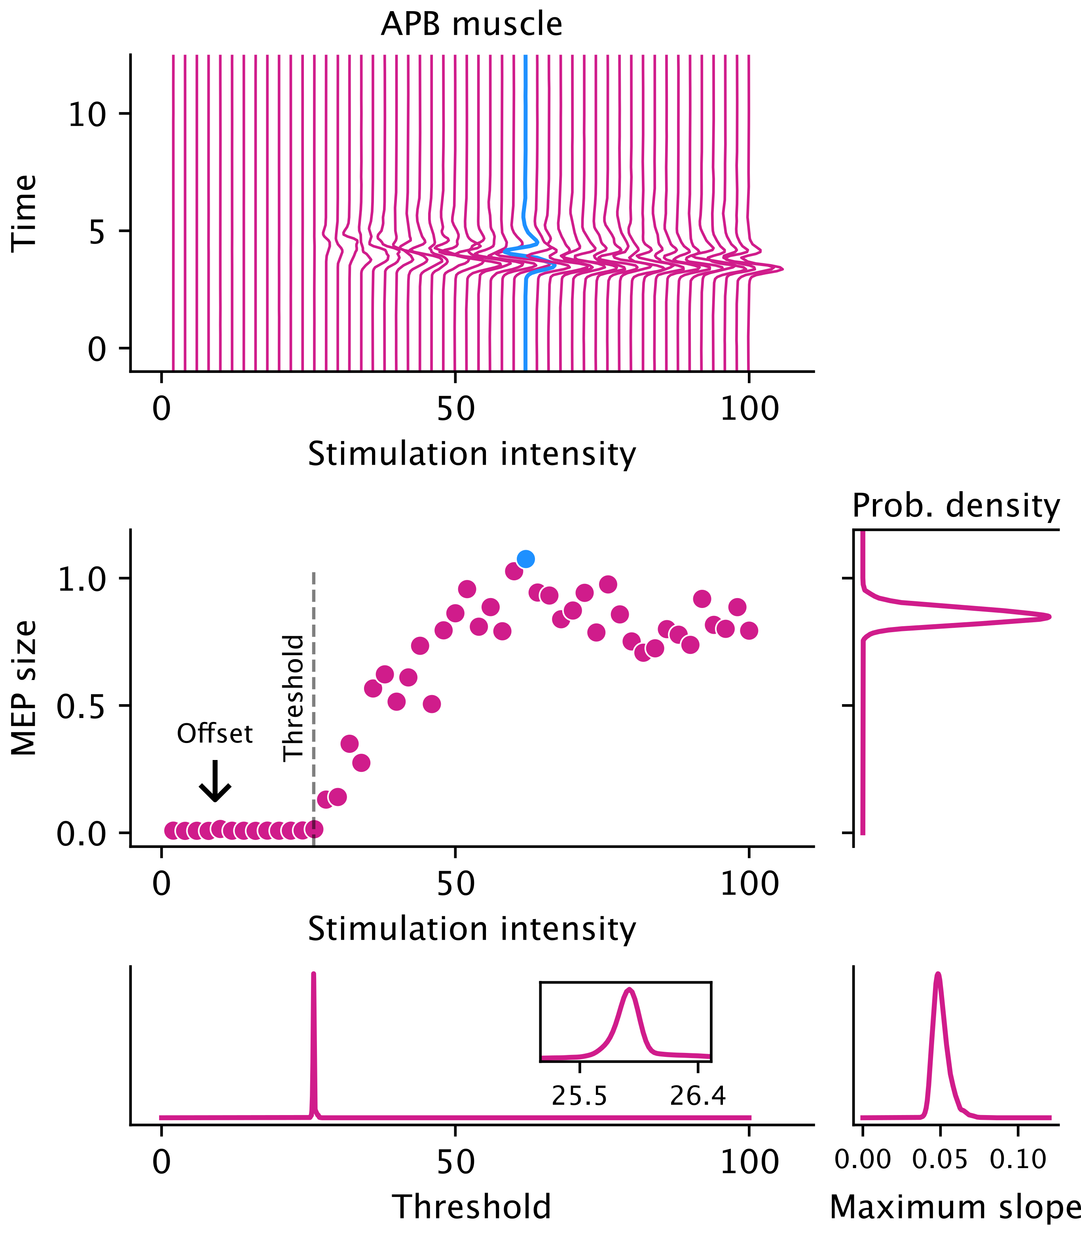
MEP recruitment curves
Recruitment curve
threshold: intensity to produce minimal consistent response above offset
key indicator of neuromuscular excitability

Slide 6

MEP recruitment curves
Recruitment curve
threshold: intensity to produce minimal consistent response above offset
key indicator of neuromuscular excitability
logistic or sigmoid functions can’t estimate this

Slide 7
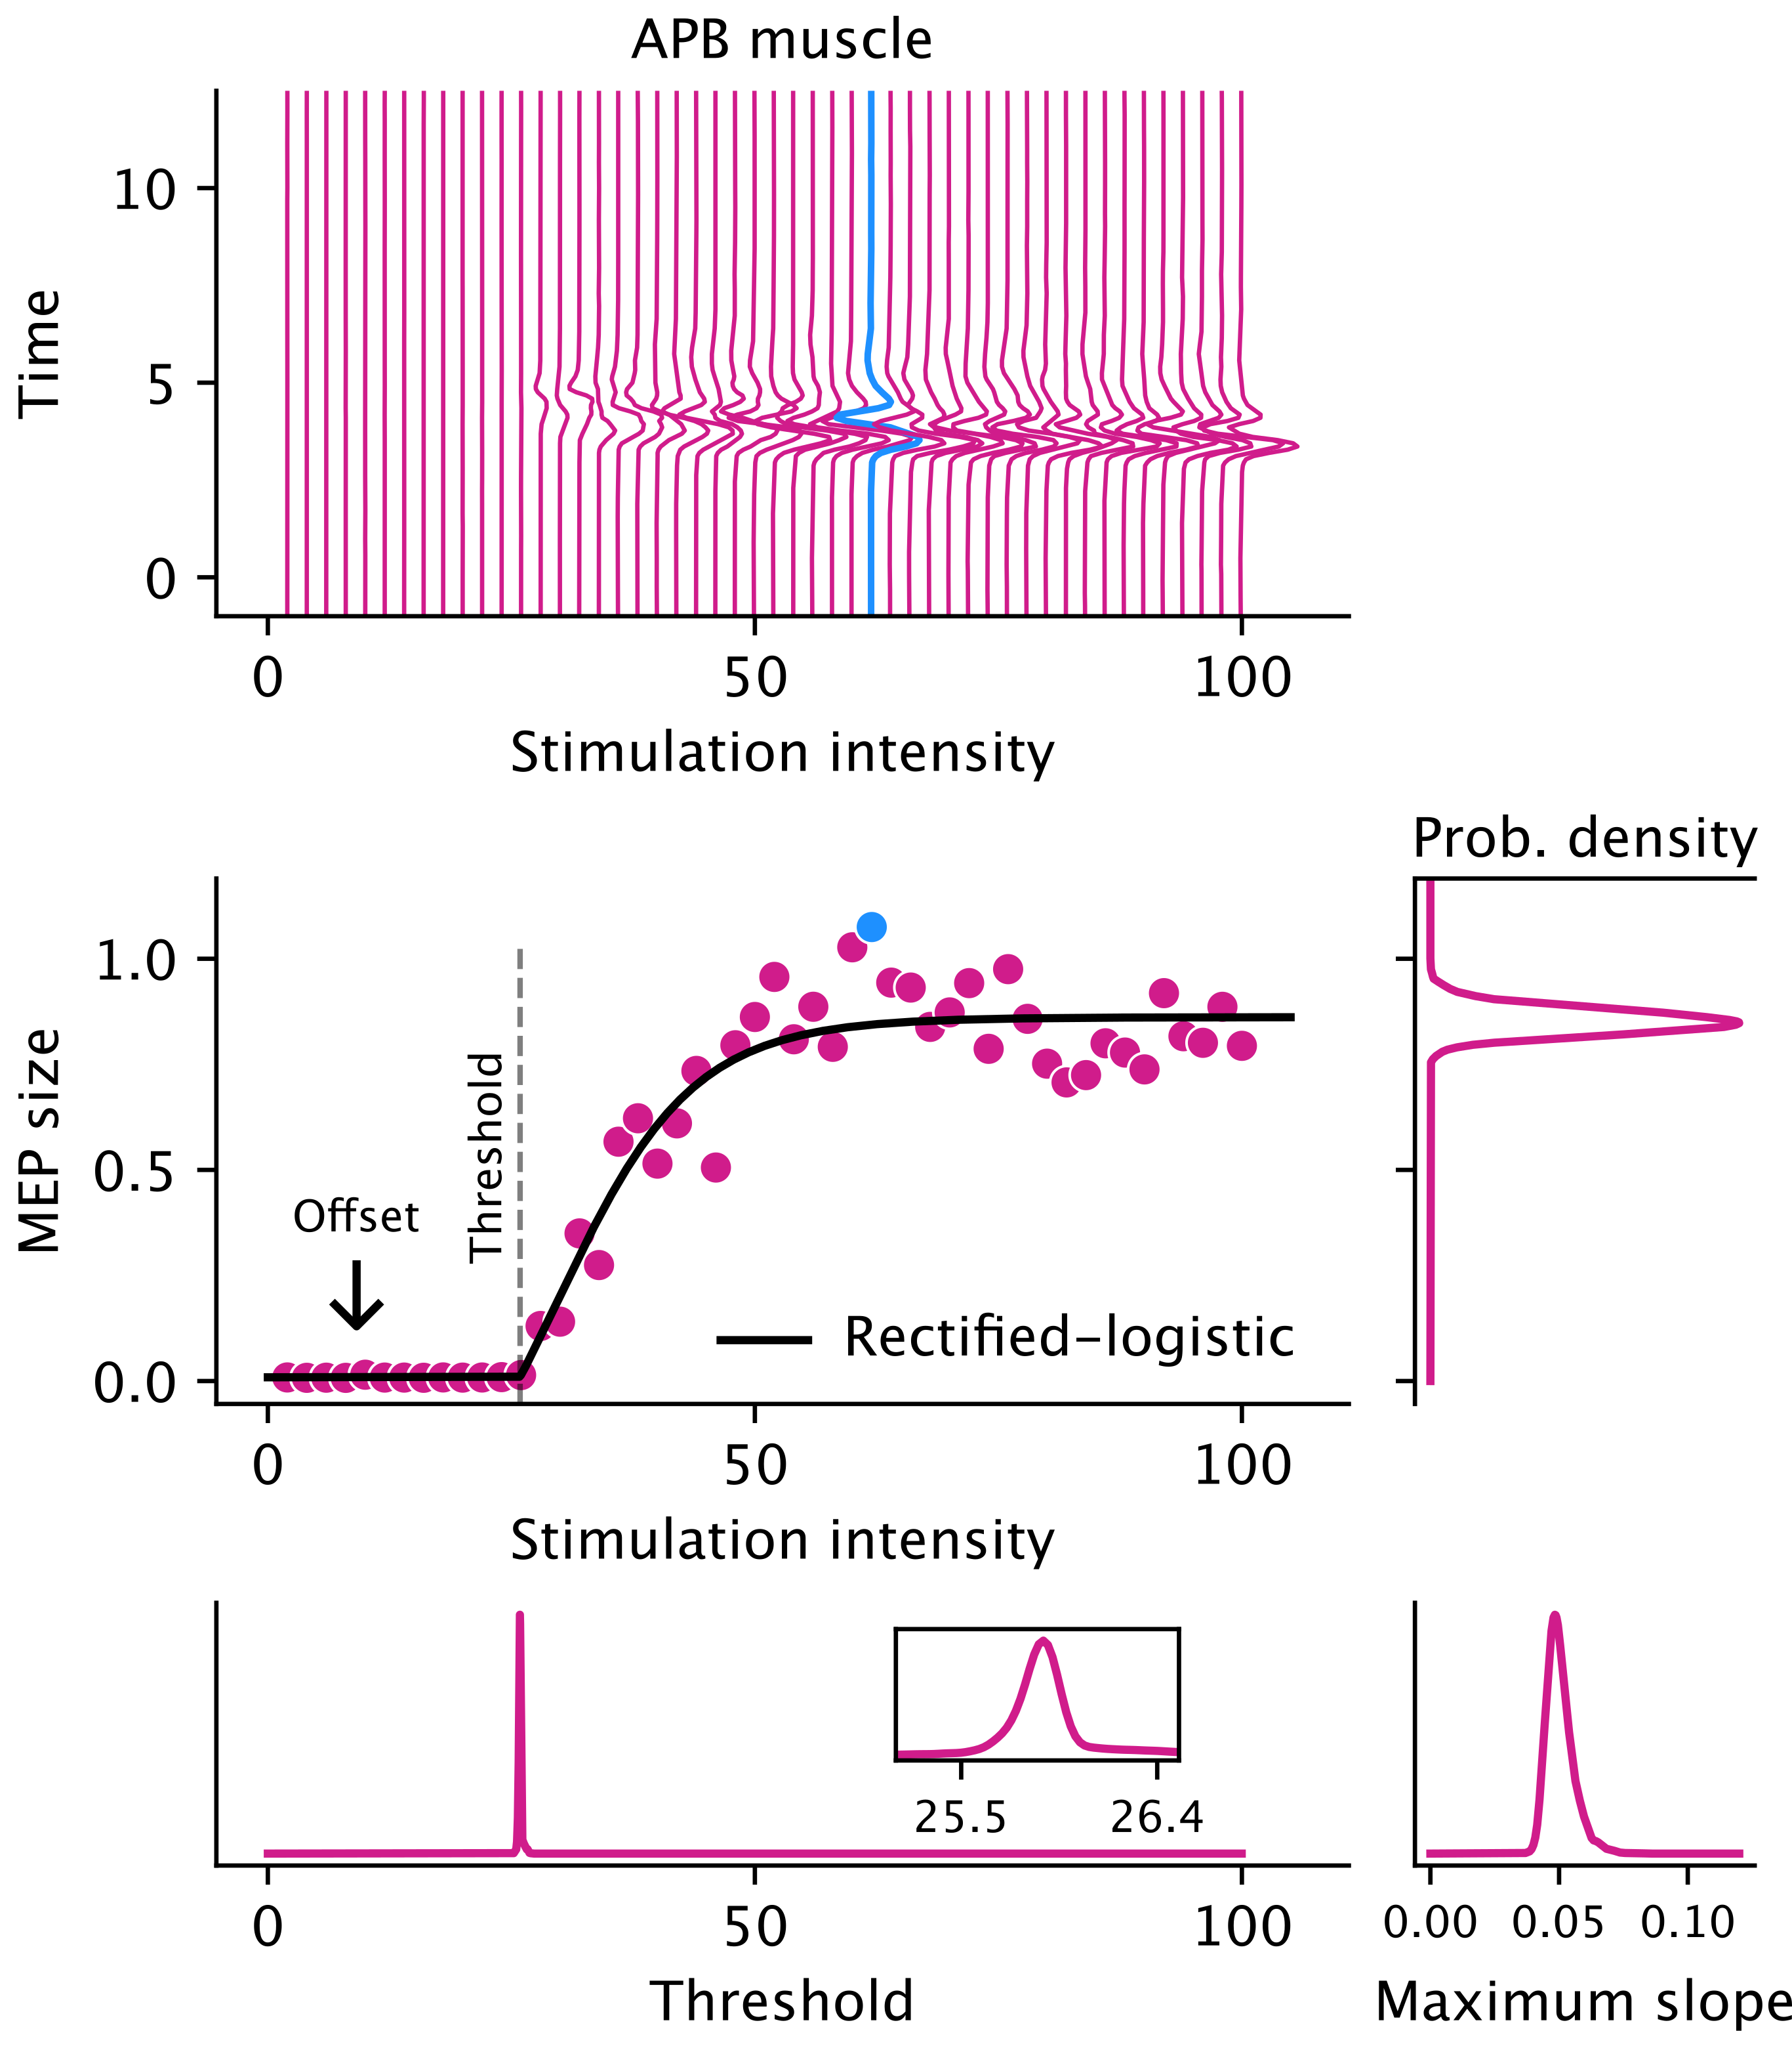
MEP recruitment curves
Recruitment curve
threshold: intensity to produce minimal consistent response above offset
key indicator of neuromuscular excitability
logistic or sigmoid functions can’t estimate this
rectified-logistic function
estimate threshold, along with other parameters

Slide 8
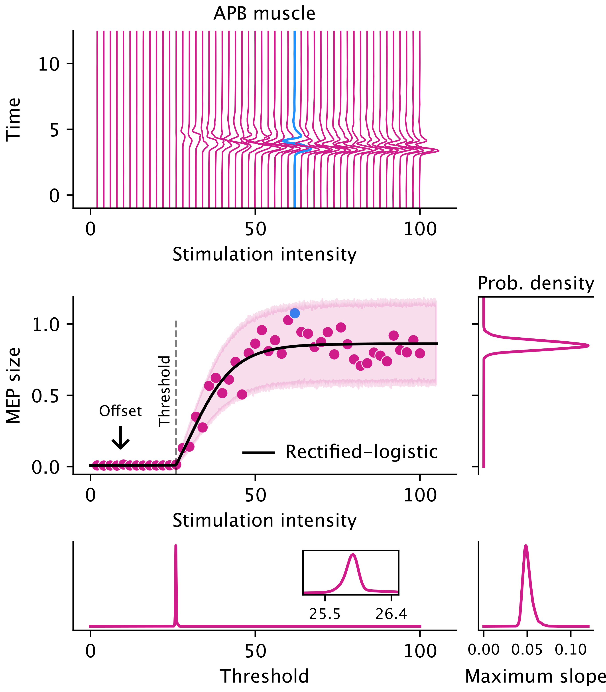
MEP recruitment curves
Recruitment curve
threshold: intensity to produce minimal consistent response above offset
key indicator of neuromuscular excitability
logistic or sigmoid functions can’t estimate this
rectified-logistic function
estimate threshold, along with other parameters
Hierarchical Bayesian gamma regression
simultaneously estimate recruitment curves for multiple participants
posterior distributions over curve parameters
helps quantify uncertainty in estimation using the 95% highest density interval (HDI)

Slide 9
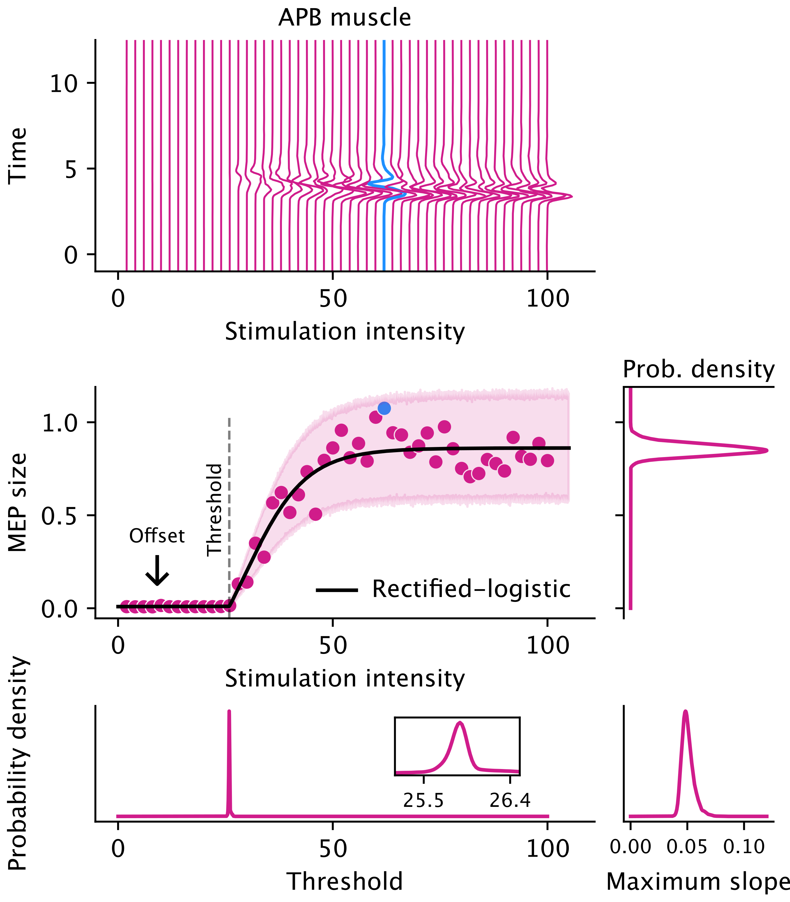
MEP recruitment curves
Recruitment curve
threshold: intensity to produce minimal consistent response above offset
key indicator of neuromuscular excitability
logistic or sigmoid functions can’t estimate this
rectified-logistic function
estimate threshold, along with other parameters
Hierarchical Bayesian gamma regression
simultaneously estimate recruitment curves for multiple participants
posterior distributions over curve parameters
helps quantify uncertainty in estimation using the 95% highest density interval (HDI)

Slide 10
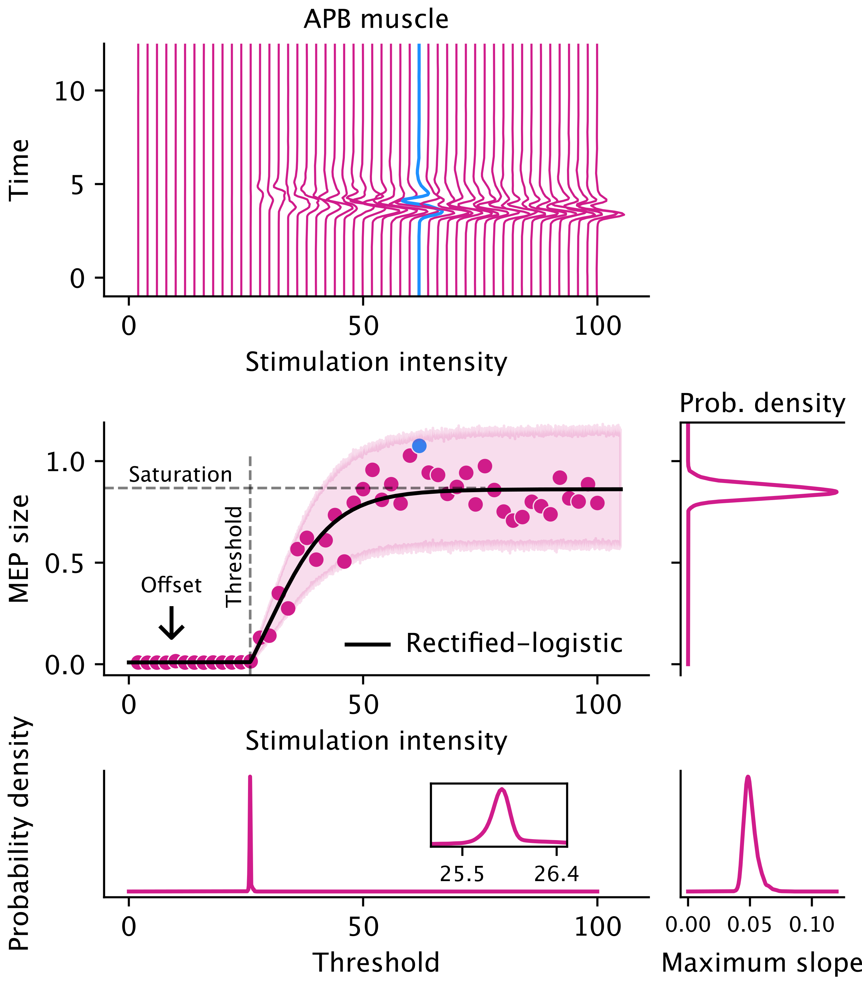
MEP recruitment curves
Recruitment curve
threshold: intensity to produce minimal consistent response above offset
key indicator of neuromuscular excitability
logistic or sigmoid functions can’t estimate this
rectified-logistic function
estimate threshold, along with other parameters
Hierarchical Bayesian gamma regression
simultaneously estimate recruitment curves for multiple participants
posterior distributions over curve parameters
helps quantify uncertainty in estimation using the 95% highest density interval (HDI)

Slide 11
MEP recruitment curves
Recruitment curve
threshold: intensity to produce minimal consistent response above offset
key indicator of neuromuscular excitability
logistic or sigmoid functions can’t estimate this
rectified-logistic function
estimate threshold, along with other parameters
Hierarchical Bayesian gamma regression
simultaneously estimate recruitment curves for multiple participants
posterior distributions over curve parameters
helps quantify uncertainty in estimation using the 95% highest density interval (HDI)

Slide 12
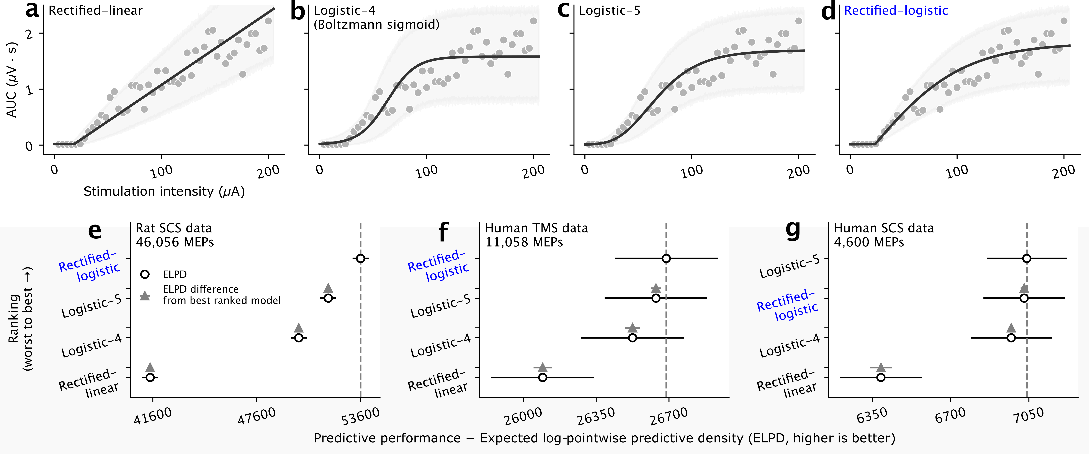
Superior predictive performance

Slide 13
Superior predictive performance

Slide 14
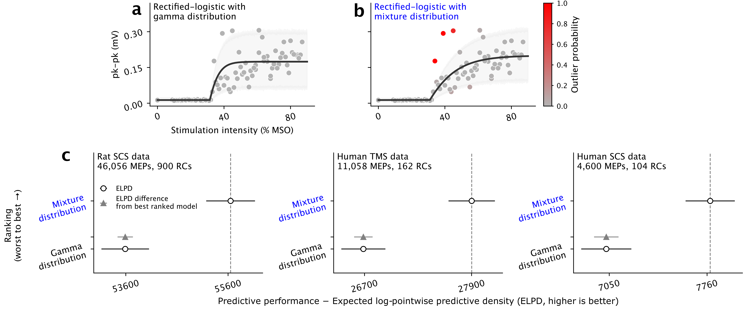
Robustness to outliers

Slide 15
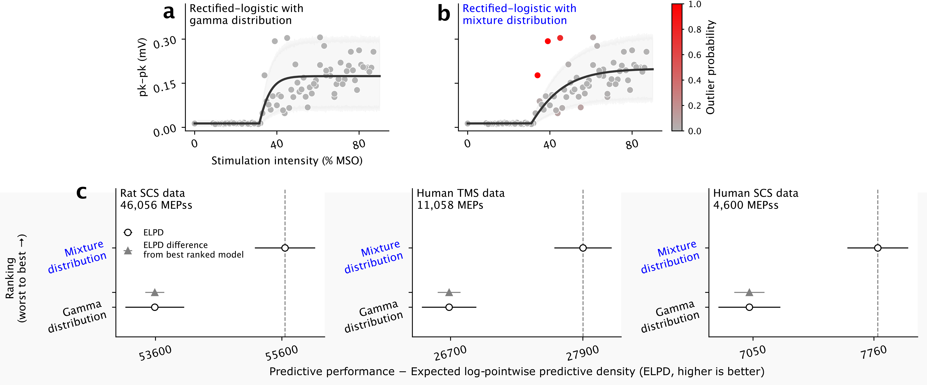
Robustness to outliers

Slide 16
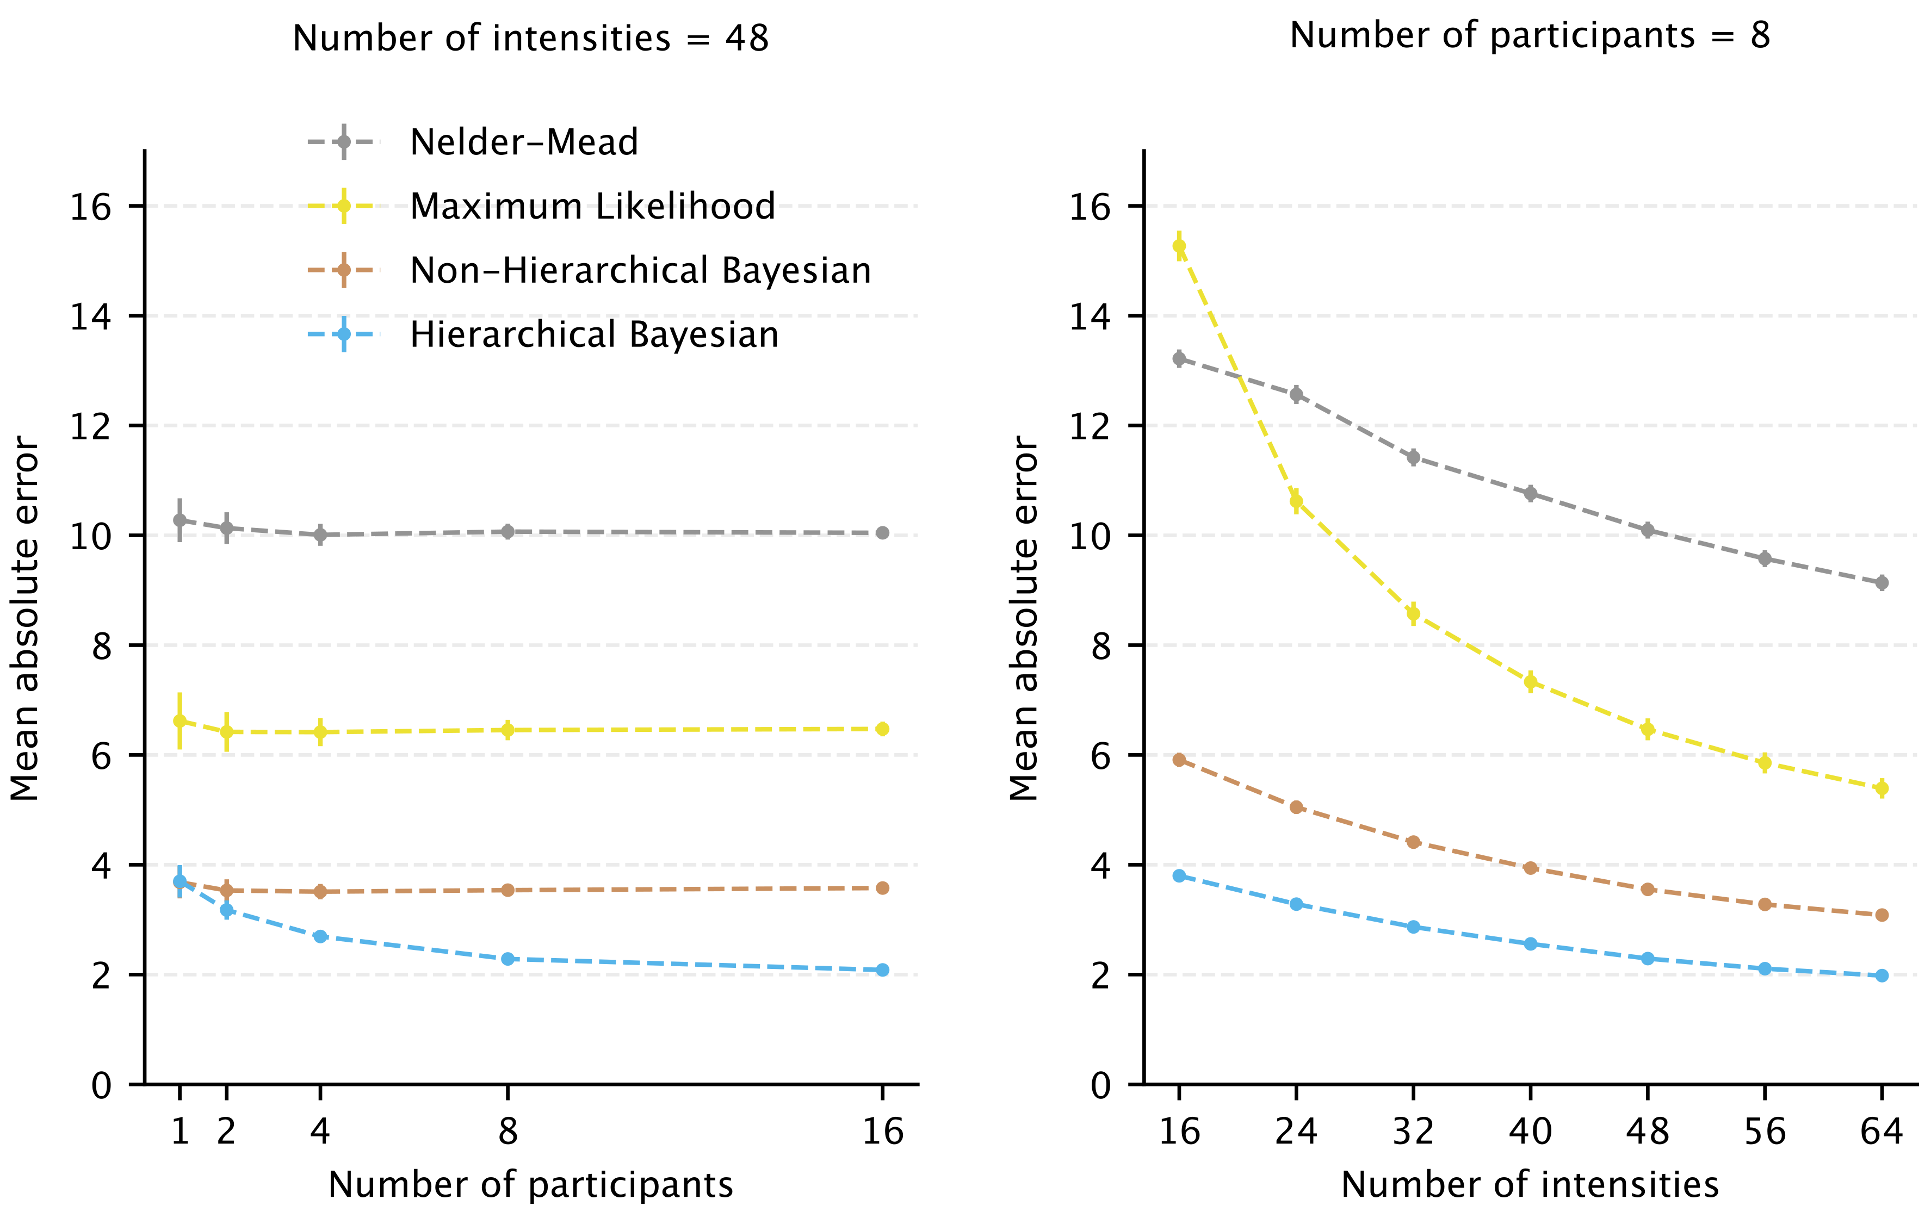
Improved threshold estimation on sparse data

Slide 17
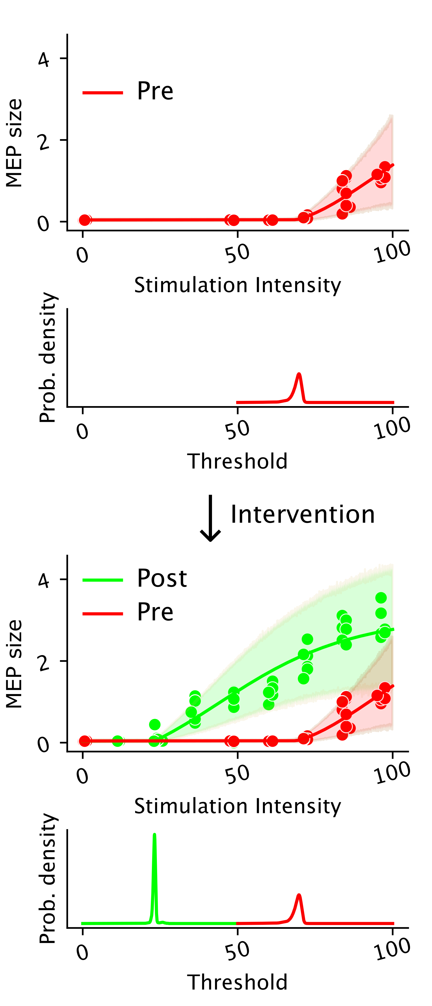
Detecting shift in threshold
Test hypotheses related to shift in threshold
useful for assessing effectiveness of an intervention
Use hierarchical Bayesian model to
estimate participant-level threshold differences between pre- and post-intervention phases
summarize the location (and scale) of these differences using population-level parameter(s)
use the 95% highest density interval (HDI) of the population-level parameter to test hypotheses
everything within the same model!

Slide 18
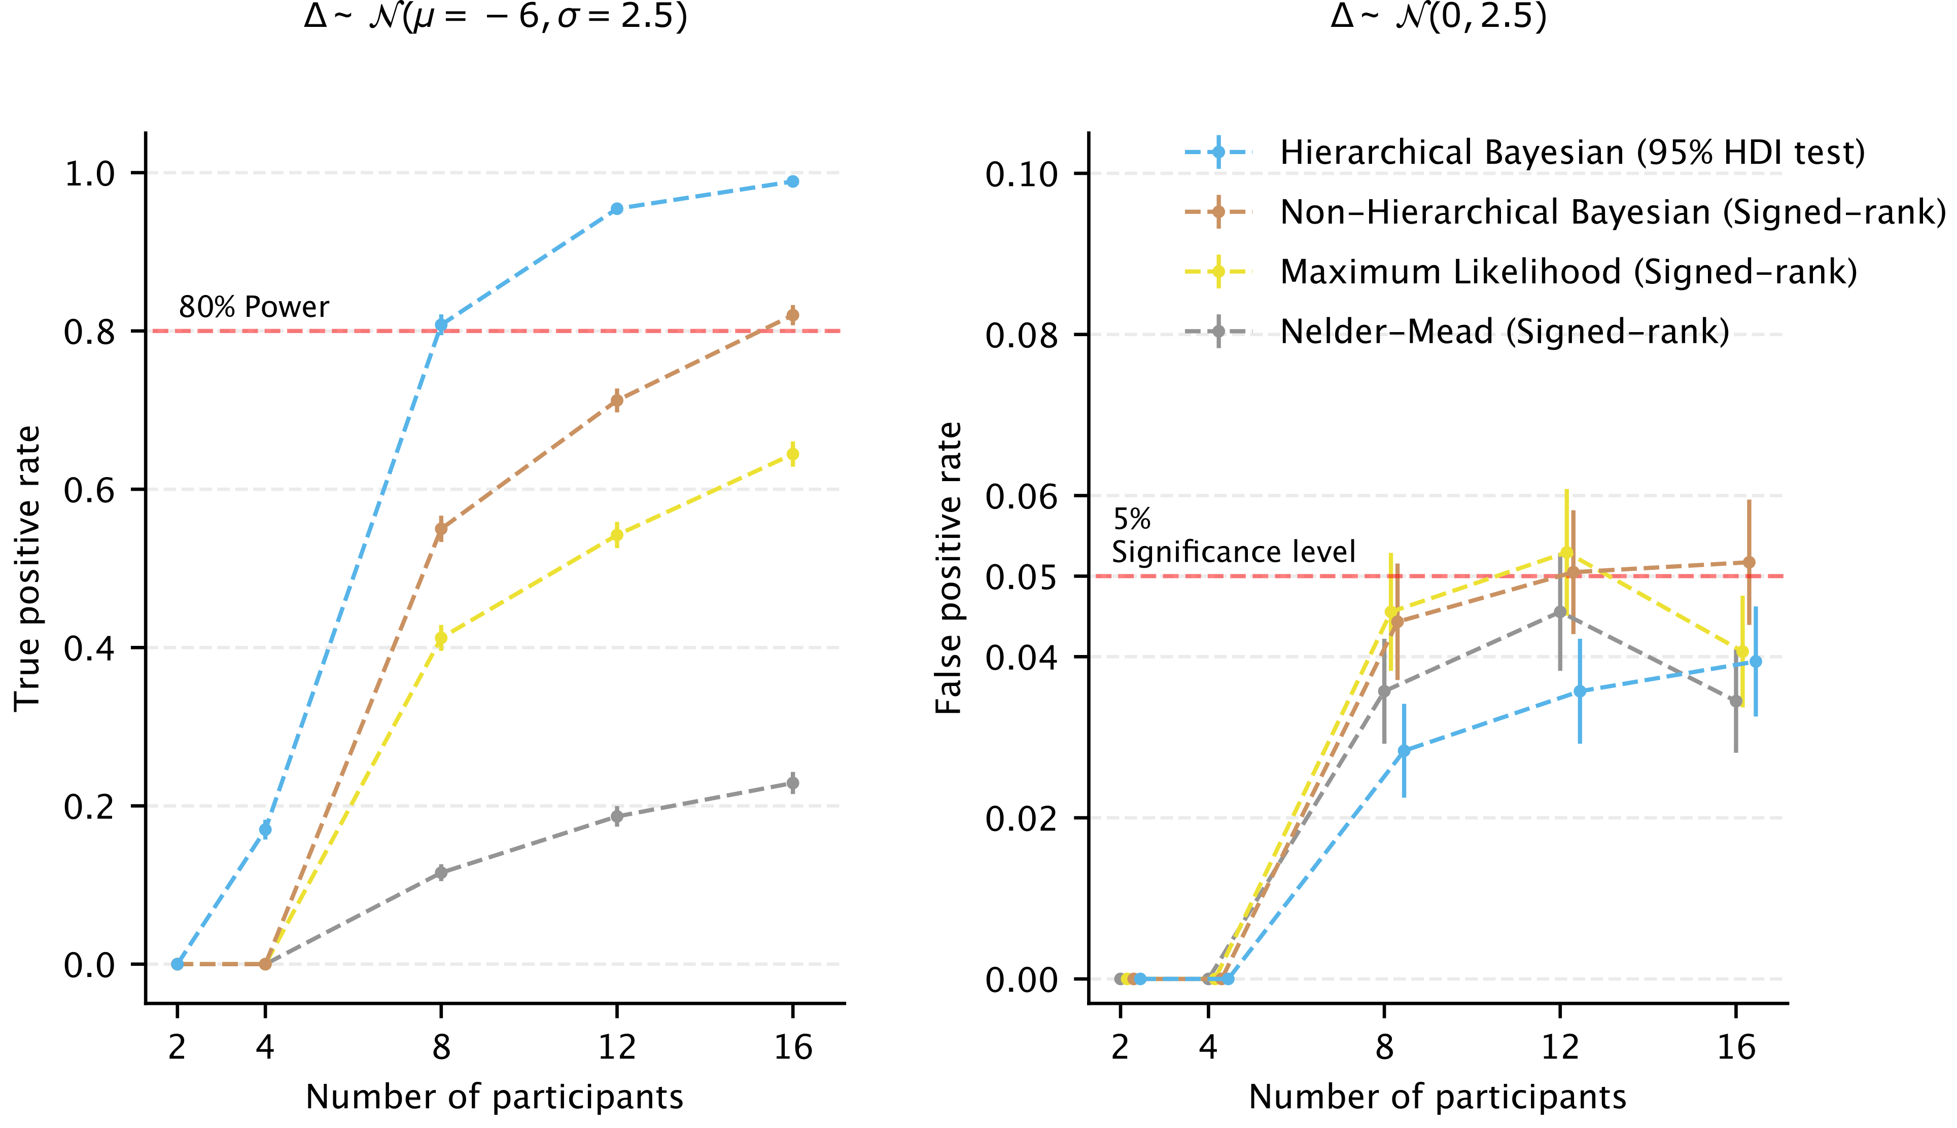
Supersedes the signed-rank test

Slide 19
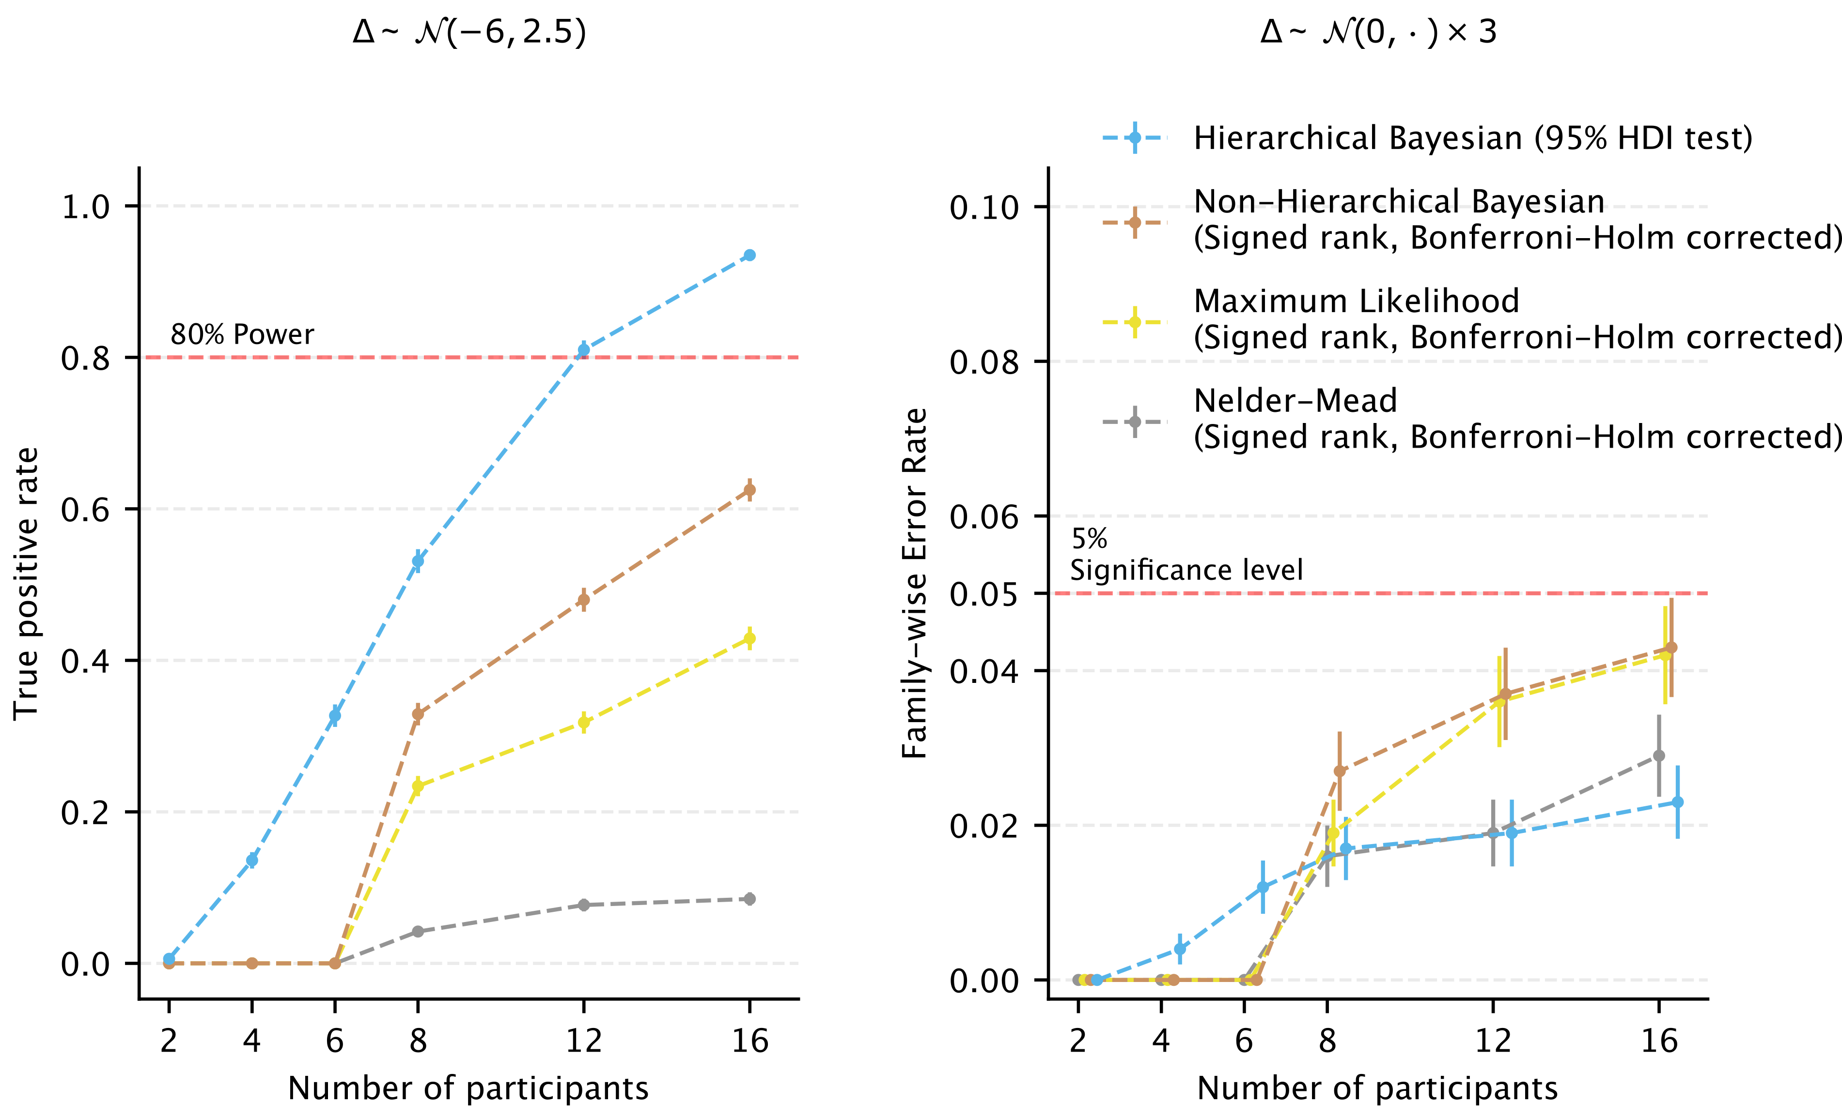
Multiple comparisons don’t require post-hoc correction

Slide 20
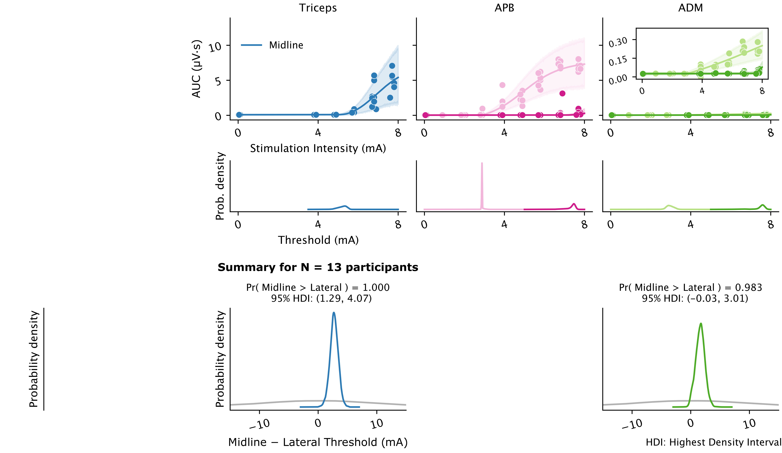
Use case – Optimizing location in spinal cord stimulation

Slide 21
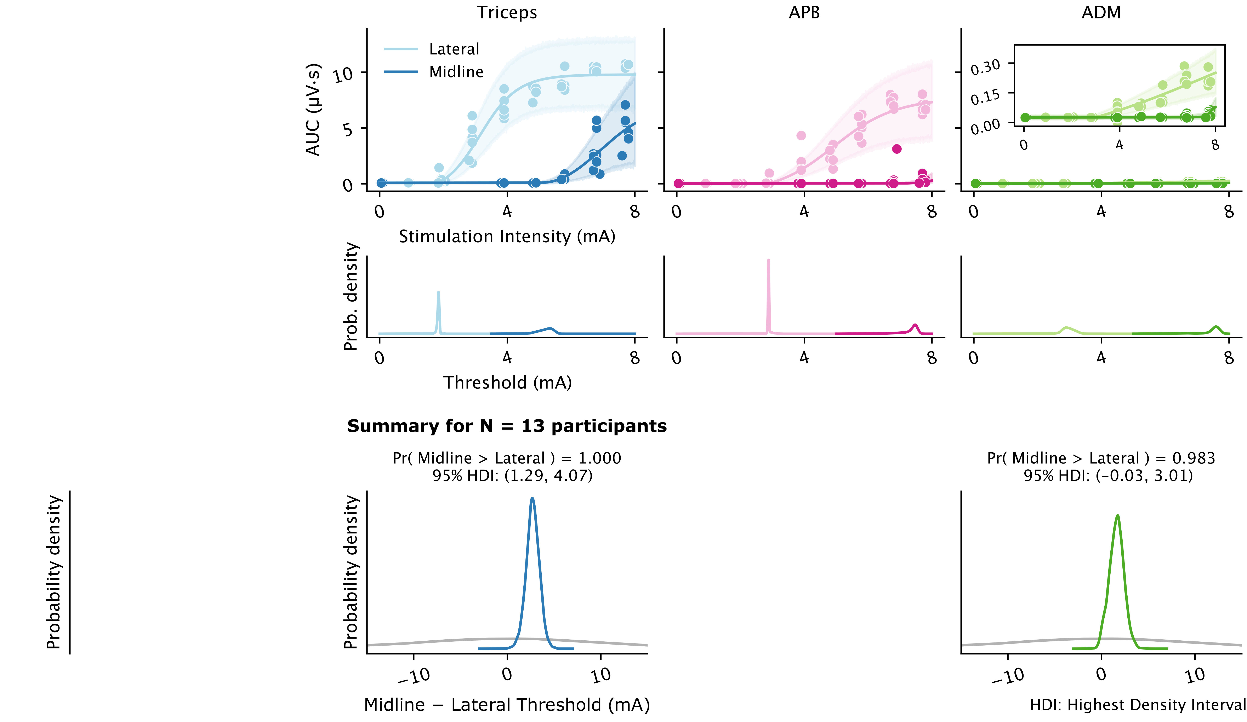
Use case – Optimizing location in spinal cord stimulation

Slide 22
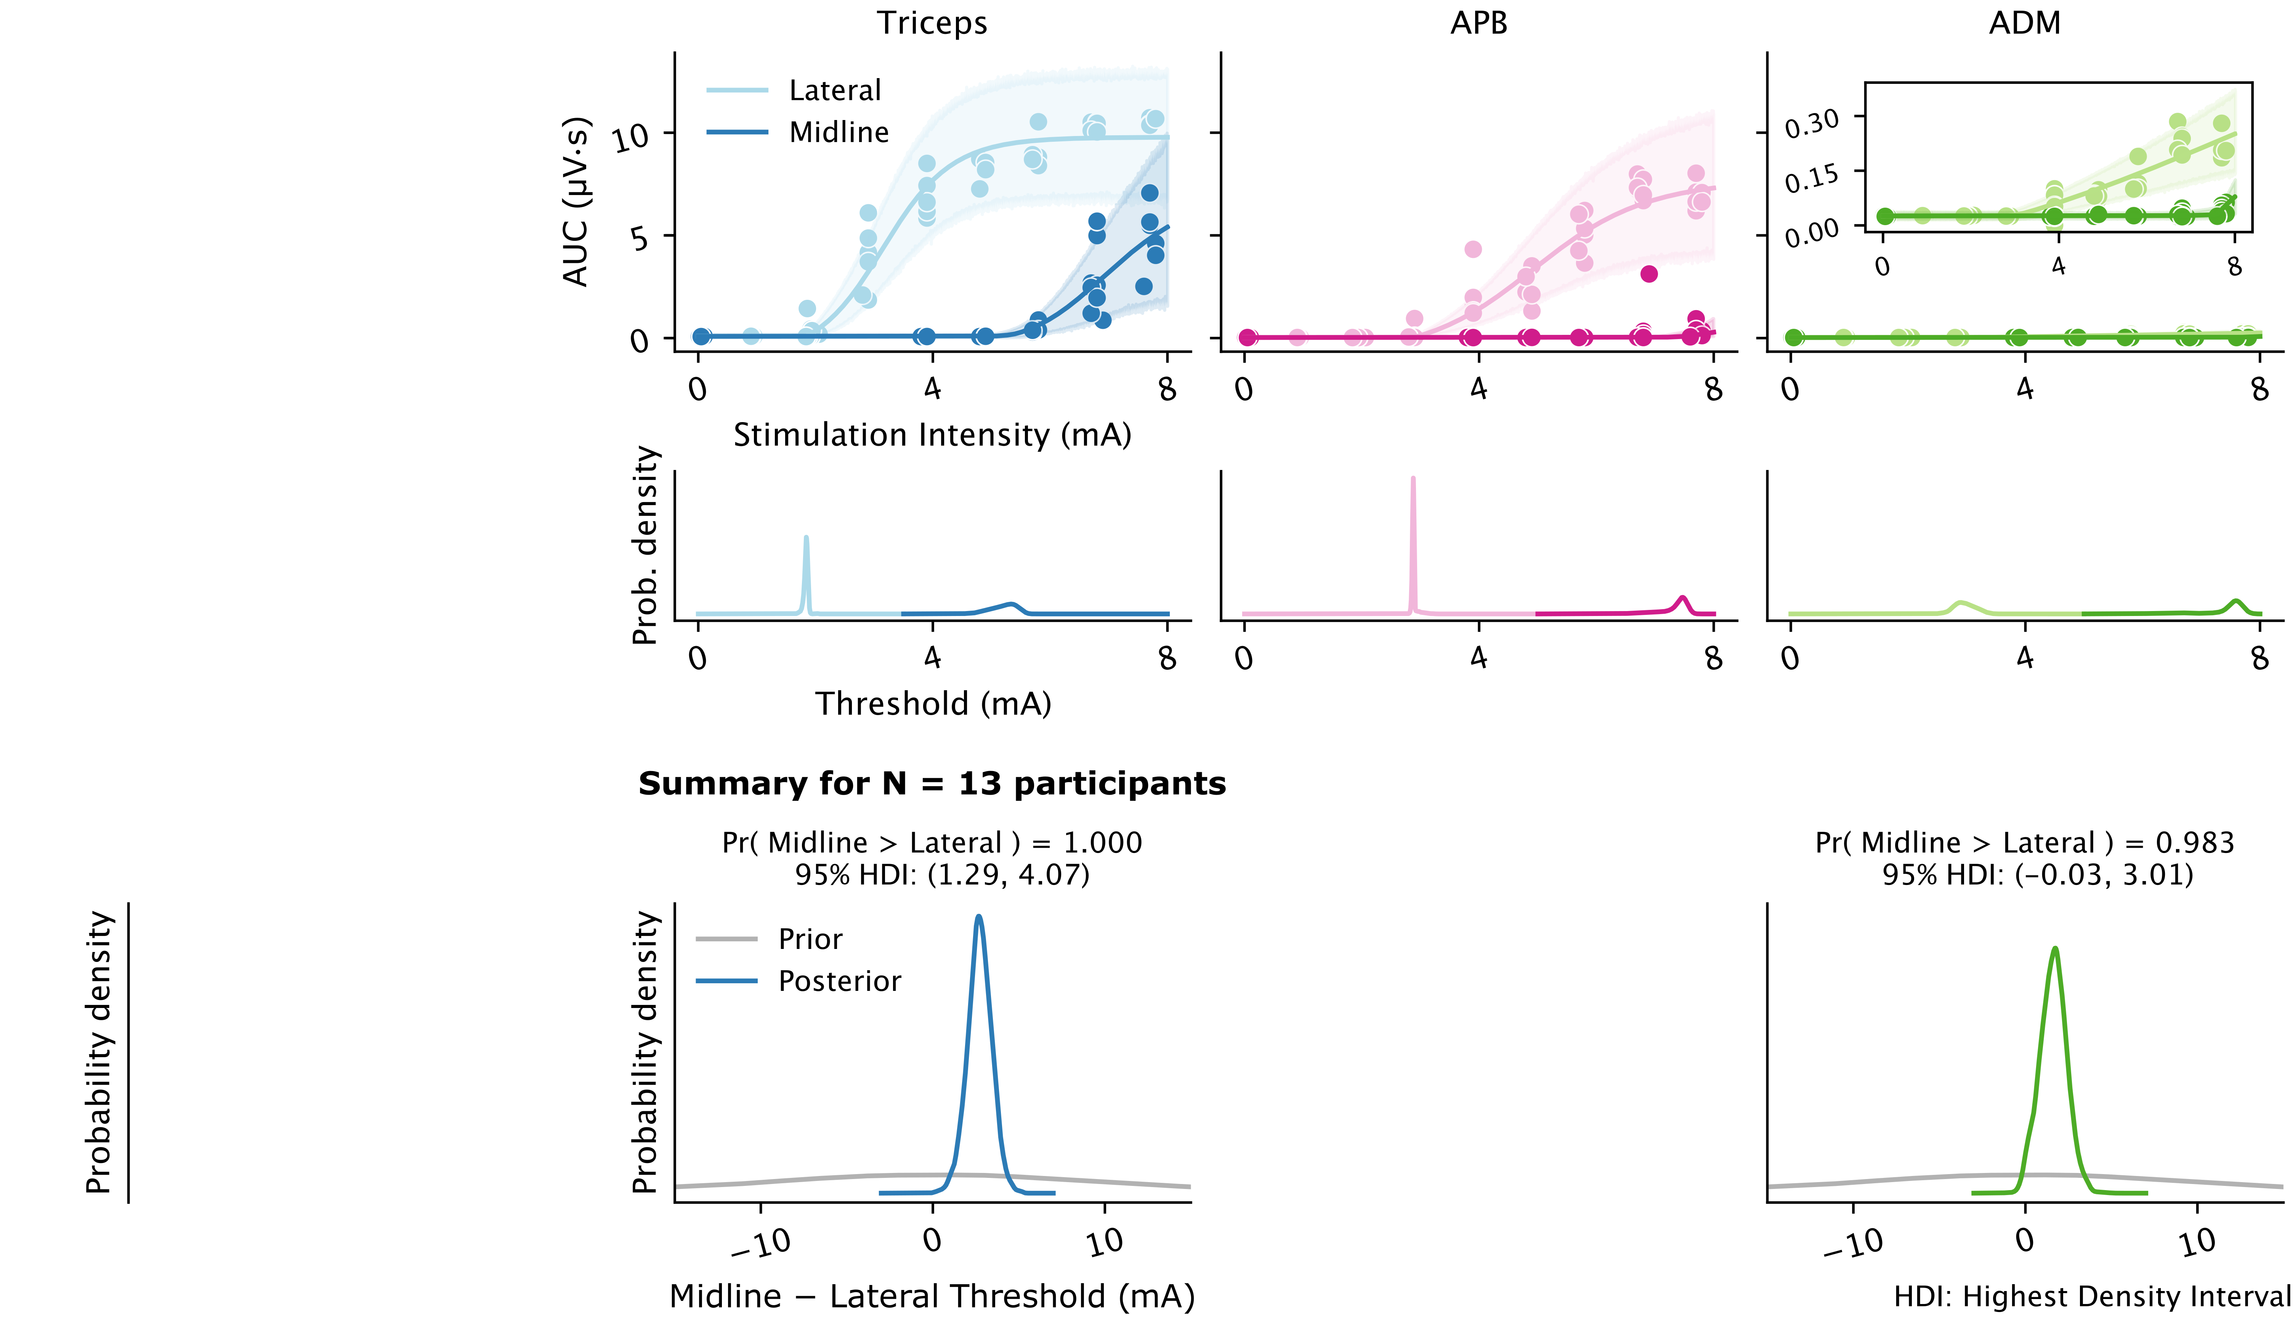
Use case – Optimizing location in spinal cord stimulation

Slide 23
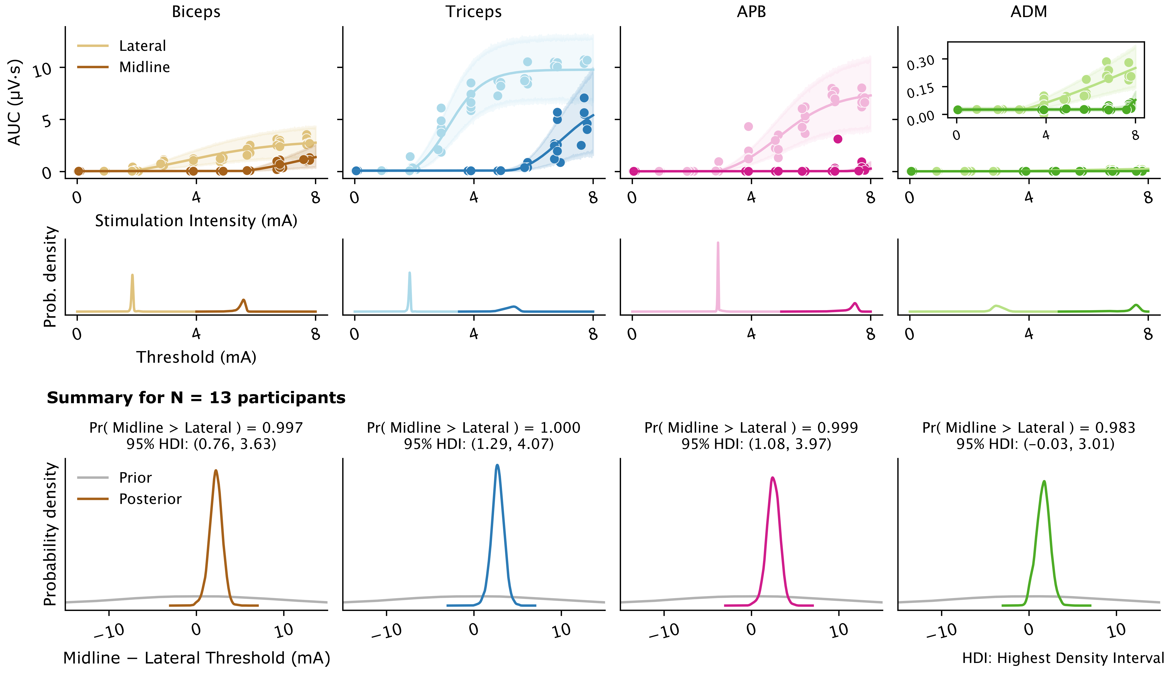
Use case – Optimizing location in spinal cord stimulation

Slide 24
Use case – Optimizing location in spinal cord stimulation

Slide 25
Use case – Optimizing location in spinal cord stimulation

Slide 26
Summary
Rectified-logistic function enables estimation of threshold, along with other key parameters
validated across human and rat datasets, including different stimulation modalities
Improved accuracy and power
reduced experimental burden on participants
hbMEP – Implemented as an open source library in Python
Online Bayes – Guide efficient sampling during live experiments across multiple muscles

Slide 27




Thank you
Collaborators L. M. Murray, A.. Asan, C. Mandigo, M. S. Virk, N. Y. Harel, J. B. Carmel, J.R McIntosh
vt2353@columbia.edu
j.mcintosh@columbia.edu
This research was supported by the National Institutes of Health (R01NS124224, R01NS115470); and the Travis Roy Foundation Boston, MA (Investigator Initiated).

Slide 28
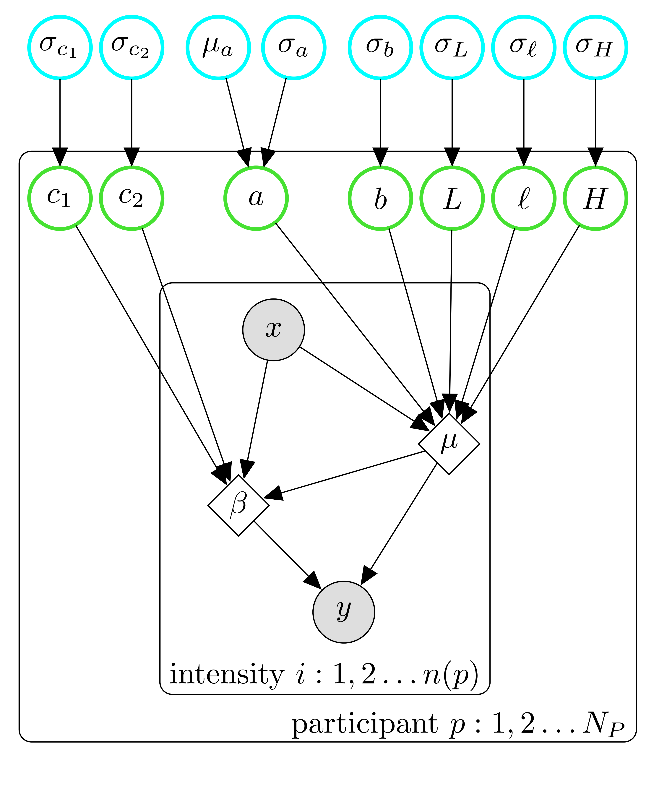
Hierarchical Bayesian model
Problem: Sparse data due to experimental constraints
non-convex search space for parameters
numerical optimizers (like Nelder-Mead) can get stuck in local minima
Approach: Hierarchical Bayesian framework!
Use hierarchical Bayesian model to
estimate participant-level and population-level parameters
participants with few samples will “shrink” or “pool” towards the overall population estimate
participants with enough samples can “diverge” more from the population estimate, depending on their data

Slide 29
Synthetic data generation
Use estimated population-level parameters to simulate synthetic data

